Slide 1
TEST Case
Test case is a set of actions execute to verify the specific functionalities of software application. It includes what to test, how to test it, what data to use, and what the expected result should be.
Main components:
Test Case ID
Test Case Description
Test Steps
Test Data
Expected Results
Actual Results
Status

Slide 2
Test case id : This field uniquely identifies a test case.
Component / Module : This field specifies the component or module that the test case belongs to.
eg : search_bar_module
Test case description / Summary : In this field, describe the test case in brief.
eg : verify that when user writes a search item and press enter , search results should be displayed

Slide 3
Pre-Requisites /Pre Condition: In this field specify the conditions or steps that must be followed before the test step execution. eg : “Browser is launched”
Test Steps : In this field , we mention each and every steps for performing the test case. The test steps should be clear and unambiguous.
eg :1. write the URL- https://google.com in the browser’s URL bar and press enter key

Slide 4
2. Once google.com is launched , write the search term “ Apple” in the Google search bar.
3. Press enter and observe the search results.
Test data : Input content required to execute one or more test cases.
In this field , we specify the test data used in the test steps.
eg : In the above test step example , we could use the search item “ apple” as test data.
Expected Result : This steps marks the expected result after the test step execution . This is used to assert the test case.
eg : Search result related to “apple” should be displayed.

Slide 5
Actual result : In this step , we specify the actual result after the test step execution.
eg: Search results with “apple “ keyword were displayed.
Status / Test Result : In this step , we mark the test case pass or fail based on the expected and actual result. Possible values can be – pass , fail, Not executed.
Test Executed By : In this field , we specify the tester’s name who executed the test case and marked the test case as pass / fail

Slide 6
Test Bed
An environment configured for testing. Test bed consists of hardware, software, network configuration, an application under test, other related software.
Eg:
Web server-IIS/Apache
database-my SQL
OS- windows
Browser- chrome
Version-version6

Slide 7
Test Data
Data used to execute the test case.
Test data is created/collected before a test is executed.
Eg:- collection of phno,address,etc

Slide 8
Test plan
A test plan is complete planning document which contains the scope, approach , resource , schedule etc.

Slide 9
Test policy
High-level documents which describes principles , methods & all the important testing goals of the organization

Slide 10
Test Scenario
Test scenario is an item or event of software system which could be verified by one or more test cases
A test scenario is defined as any functionality that can be tested.
Eg:for an E-commerce application a few test scenario would be
Scenario 1:check the search functionality
Scenario 2 :check the payment functionality
Scenario 3:check the login functionality

Slide 11
Test Suite
It is a collection of test cases. The test cases which are intended to test an application

Slide 12
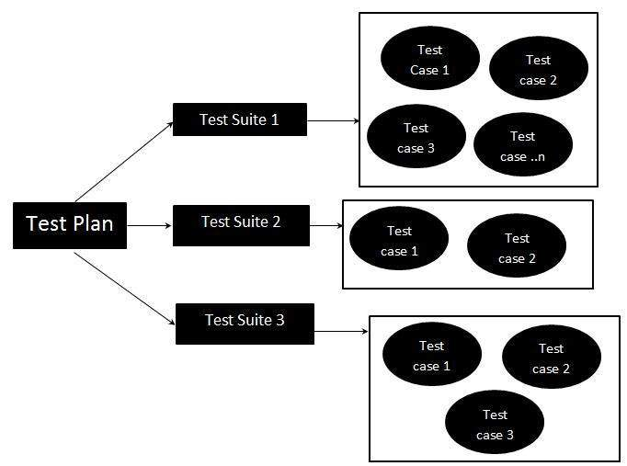
Test suite

Slide 13
Requirement Traceability Matrix
It is a document that maps and traces user requirement with test cases.
The main purpose of RTM is to see that all test cases are covered so that no functionality should miss while doing software testing cases

Slide 14
Requirement Traceability Matrix
Req no | Req Desc | Test case id | Status
123 | Login to the application | Tc01,Tc02,Tc03 | Tc01-Pass Tc02-Pass Tc03-Pass
456 | Ticket Creation | Tc04,Tc05,Tc06,Tc07 | Tc04-Pass Tc05-Pass Tc06-Fail Tc07-Not Executed
678 | Search Creation | Tc011,Tc012,Tc013,Tc014 | Tc011-Pass Tc012-Fail Tc013-Pass Tc014-Not Executed

